Slide 1
Ancient units
 | “GREAT ROUTES IN THE MIDDLE AGE AND THEIR SYMBOLOGY” Nr. 2016-1-ES01-KA219-025035_3
Latvia
Elizabete Kovtuna

Slide 2
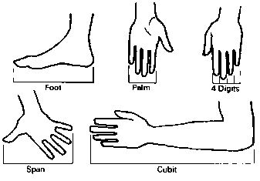

Slide 3
Units that might help
Cubit - A unit of length equal to 0.443 meters or 18 inches.
Foot - 12 inches. Length of (large) man's foot.
Inch - 10 lines. 1000 mils. Width of man's thumb, length of 3 barley corns (Anglo-Saxon).
Hand - 4 inches. Width of man's hand; used for height of horse at its withers (shoulders). Formerly, approx. 5 inches.

Slide 4
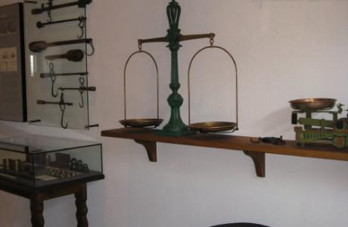
Weight units
Latvian to mid-19th century use a unit – Birkavs.
Birkavs equal to 20 pots (podi) ; 400 pounds ; ~ 167,52kg
1 pot =20 pounds (mārciņas) ; 8,376 kg

Slide 5
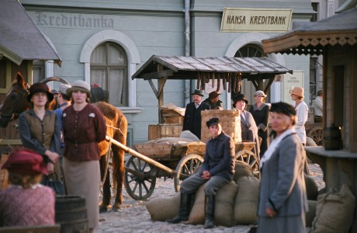
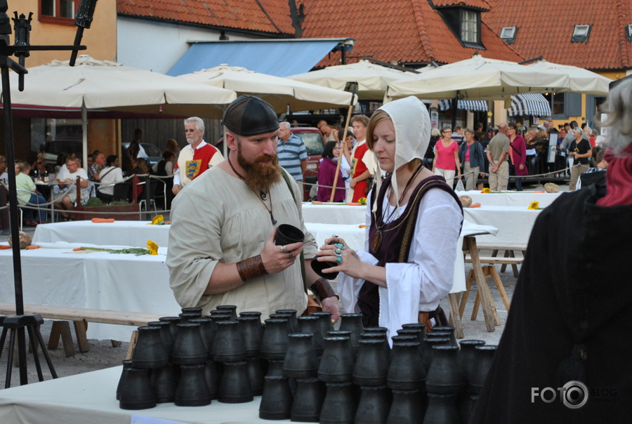
Length units
1 cubit (fabric unit) - 2 feet - 24 inches - 53,75cm (Riga cubit). Latvian mayor used this to 1824, when it replaced the Russian length unit - Arsin (71,1cm);
RĪGAS ASS (Rigas axis) = 3 cubit = 6 feet =161,25 cm
KORTELIS = ¼ cubit = 6 inches =13,44 cm
RĪGAS MĒRRĪKSTE = 14 feet = 7 cubit = 376,25 cm

Slide 6
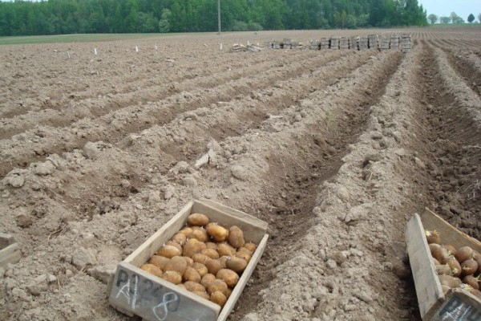
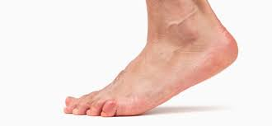
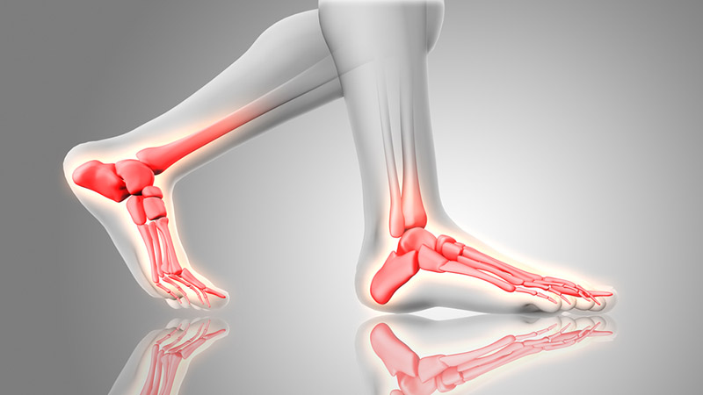
Areas units
Riga 7 cubit mērrīkste = 14,156 m²
Cord – ground lines, the land divided into lines
The most common ones - foot and step.

Slide 7
Volume unit
Dowry (in square boxes) - bulk products, eg. corn, potato unit.( 15 and 16th century.)
Dowry height of 32cm and a diameter of 56,5cm meet ~ 69kg;
Sieks - product unit for wheat, rye, buckwheat and other at 15 and 16th century. It is height - 15,6cm and diameter - 31,6cm;
Salt barrel - 1/16 barrel unit - the name itself already suggests that was used as a unit for salt. It was 76,7cm height and diameter - 48,8cm

Slide 8
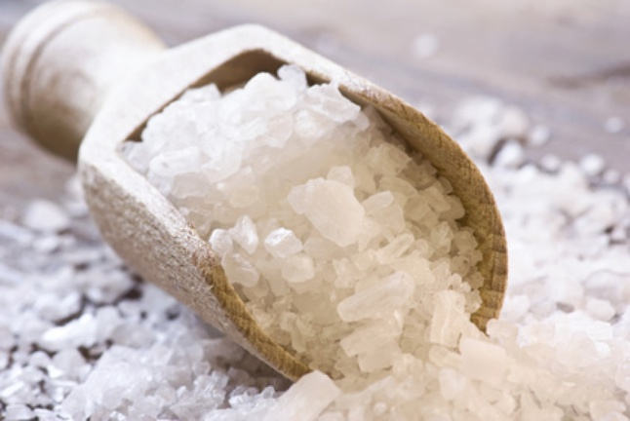
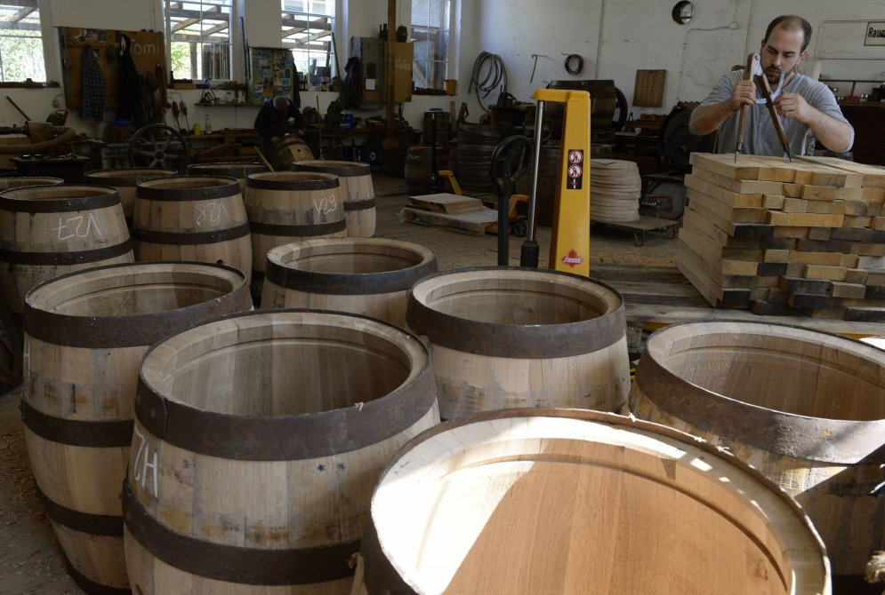
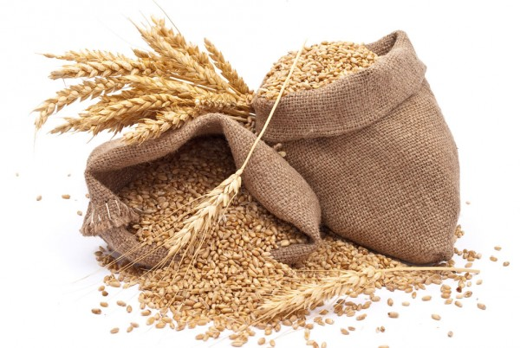

Slide 9
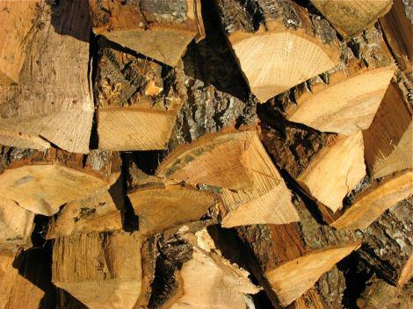
Wood axis
1) 6x6 feet 5 stretches(sprīdis) past the end of wood;
2) 9x9 feet;
3) 11x11 feet.

Slide 10
More information
http://www.everingham.com/family/data2/rec0034.html

Slide 11
Information from:
http://spoki.tvnet.lv/vesture/Tautas-senie-meri/721589
http://www.vvk.lv/index.php?sadala=166&id=444

Slide 12
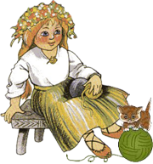
Thank you!

