Slide 1
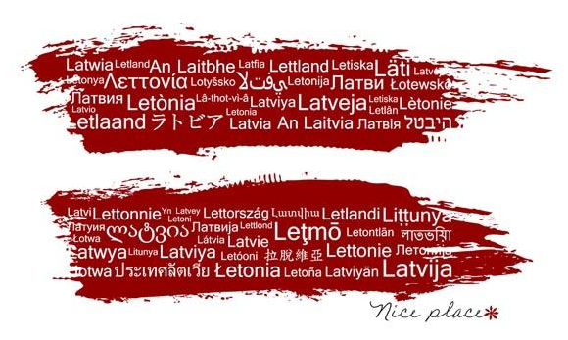
something about Latvia

Slide 2
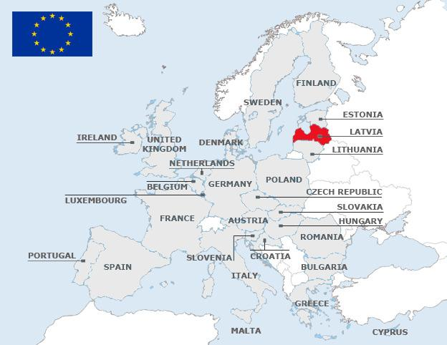
Latvia in European Union

Slide 3
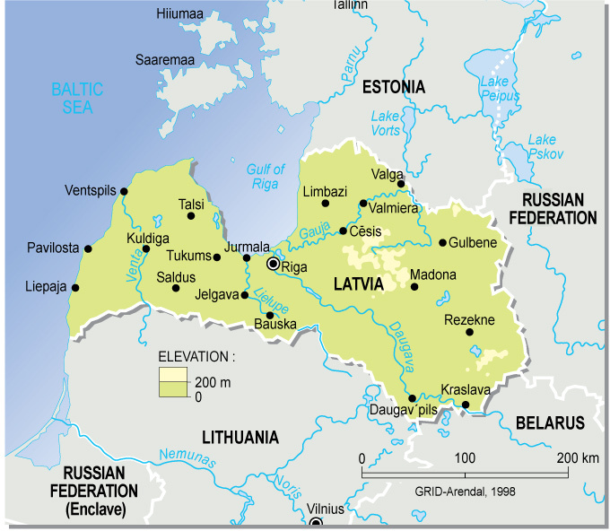
the map of Latvia
You can see:
our capital Riga,
Jelgava – city where we live and river Lielupe which flows through the city,
the biggest river of Latvia Daugava,
gulf of Riga of Baltic sea,
our neighbour countries

Slide 4
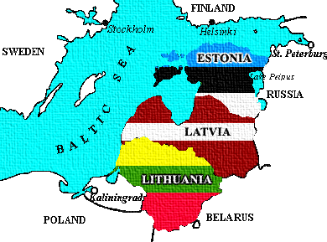
The closest contacts we have with our Baltic «destiny sisters» - Lithuania and Estonia.
After the Baltic states had restored independence in 1990, integration with Western Europe was chosen as the main strategic goal.
In 2002 the Baltic nations applied to become members of the North Atlantic Organization Treaty (NATO) and the European Union (EU).

Slide 5
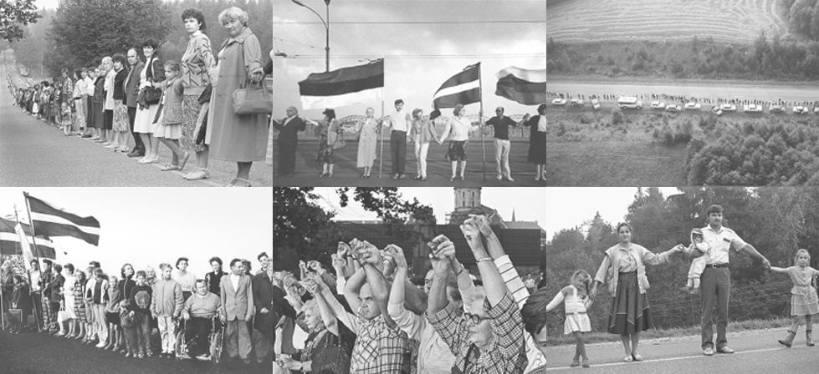
The Baltic Way or Baltic Chain (also Chain of Freedom) was a peaceful political demonstration that occurred on August 23, 1989. Approximately two million people joined their hands to form a human chain spanning 675.5 kilometres (419.7 mi) across the three Baltic states – Estonia, Latvia and Lithuania, considered at the time to be constituent republics of the Soviet Union.

Slide 6
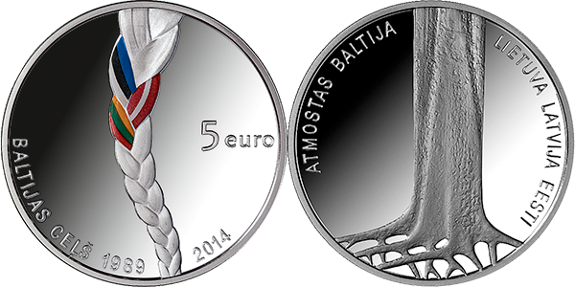
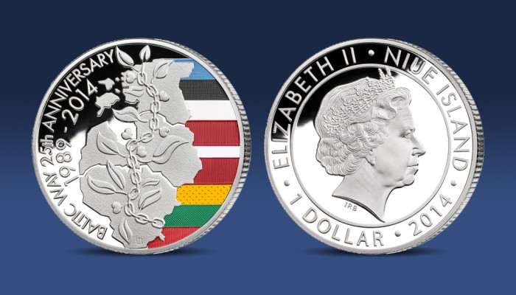
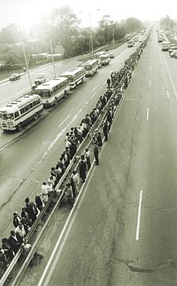
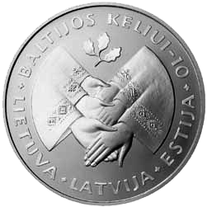
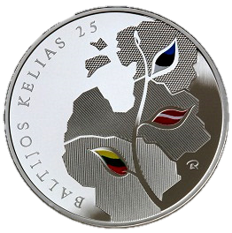
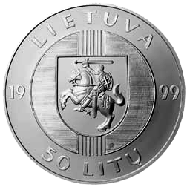
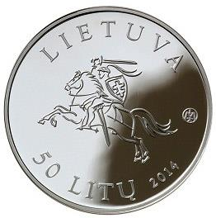
Baltic Way memorial coins from Latvia (EUR 5) and Lithuania (1$ and 50 Lt)

Slide 7
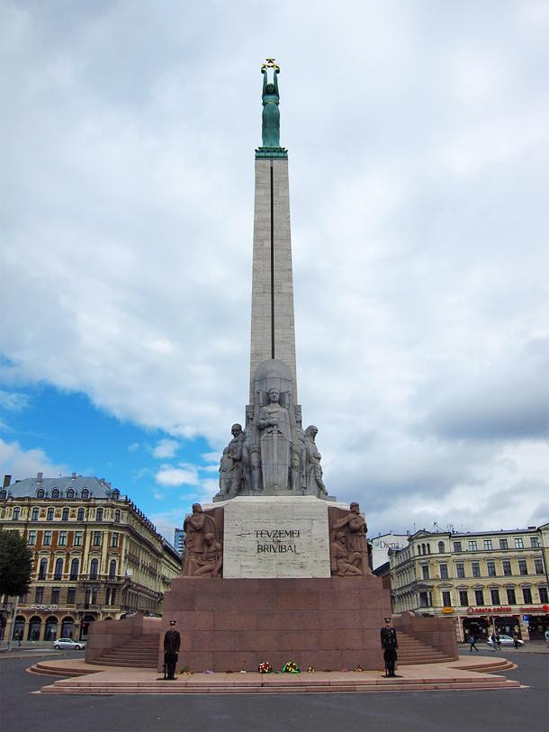
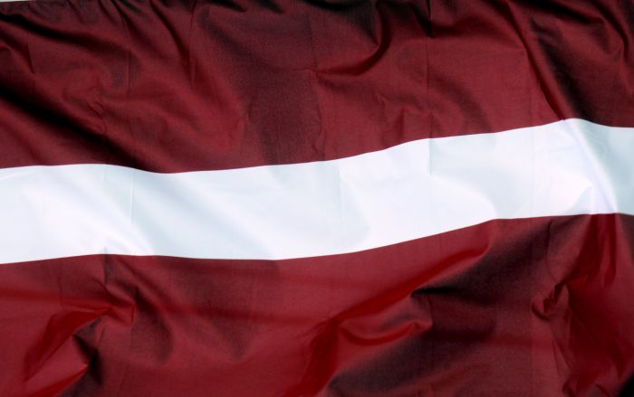
Latvian «holy site» – monument of Freedom
in Riga
Flag of Latvia

Slide 8
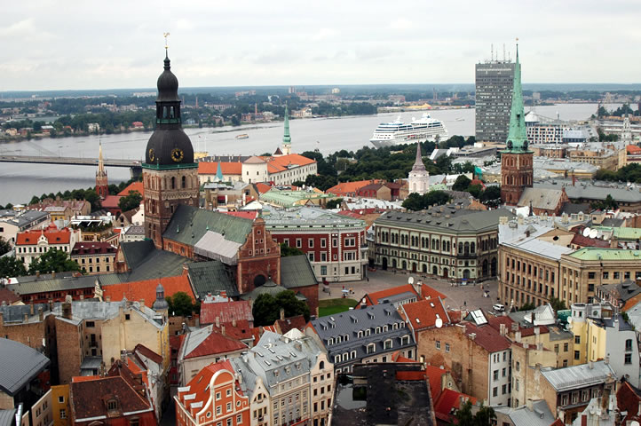
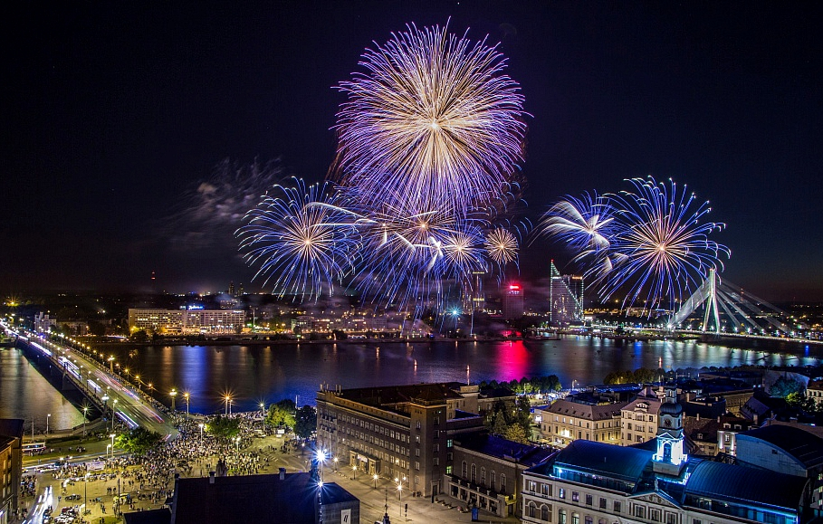
The capital of Latvia is Rīga. In year 2001, 800th anniversary was celebrated. There are about 800 000 inhabitants.
18 of November Independence Day firework.

Slide 9
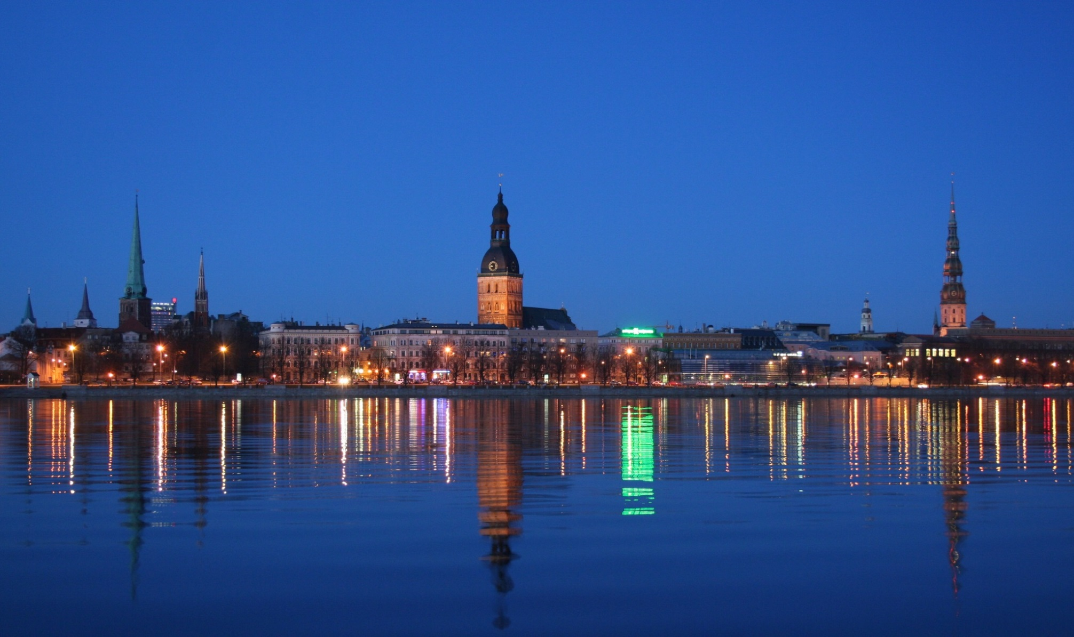
Riga – panoramic view

Slide 10
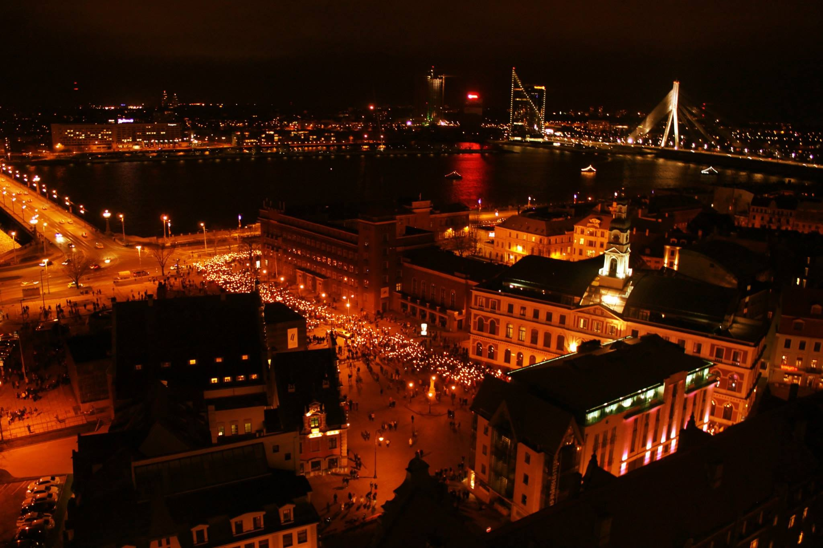
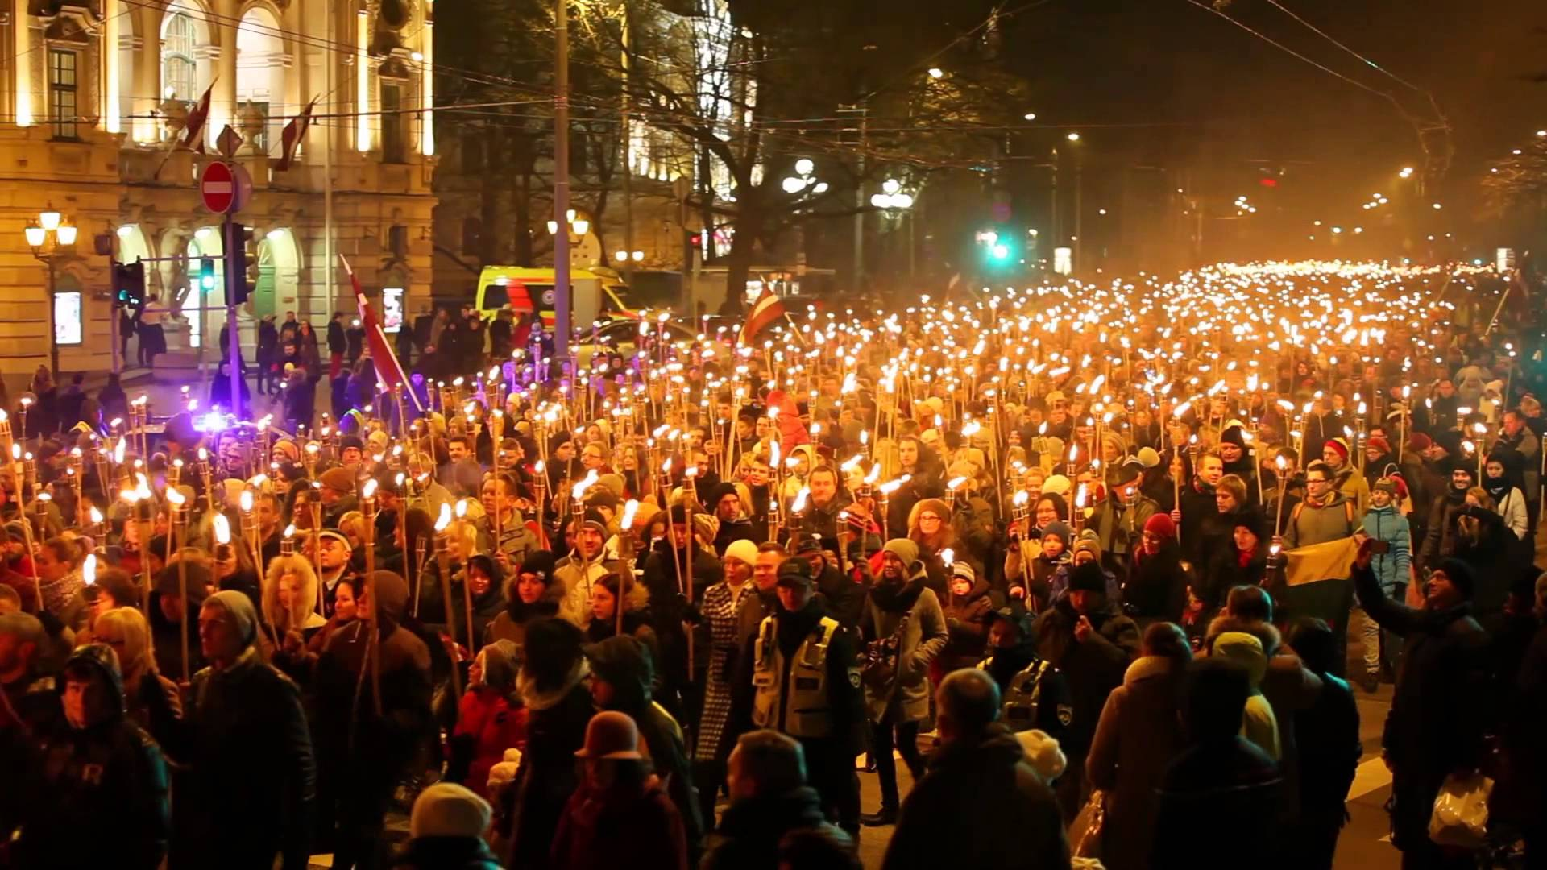
Independence Day Torch procession

Slide 11
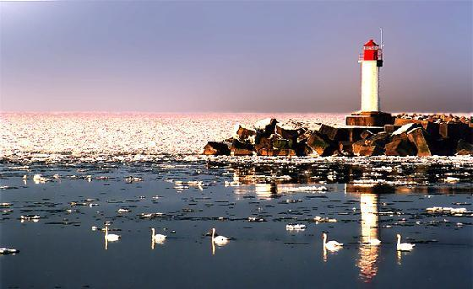
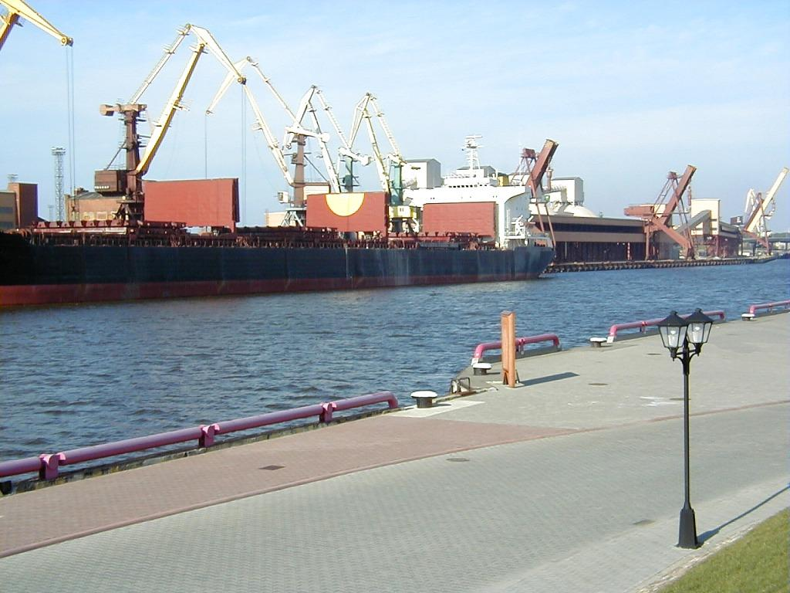
Latvia has three harbour towns Liepāja, Rīga, Ventspils. According to turnovers Ventspils is the biggest in Baltic States.
Approximately 2 million inhabitants live in Latvia, about 60 % are Latvian.

Slide 12
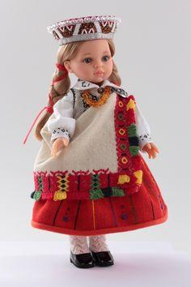
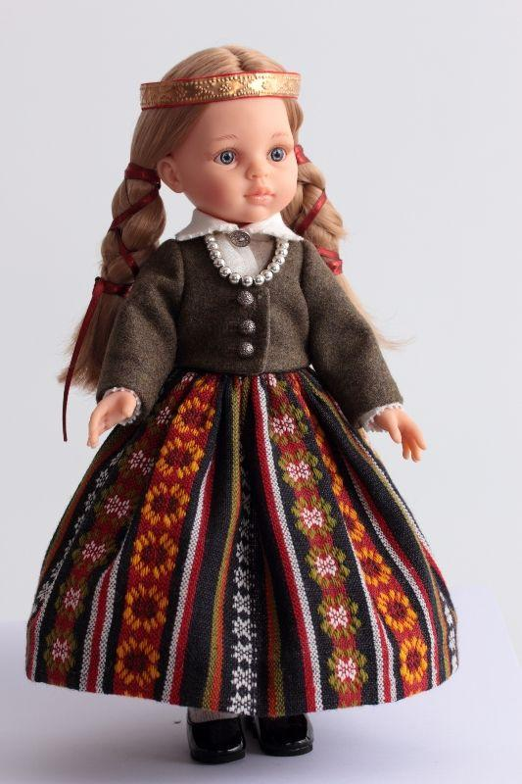
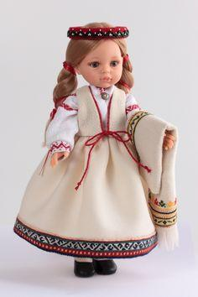
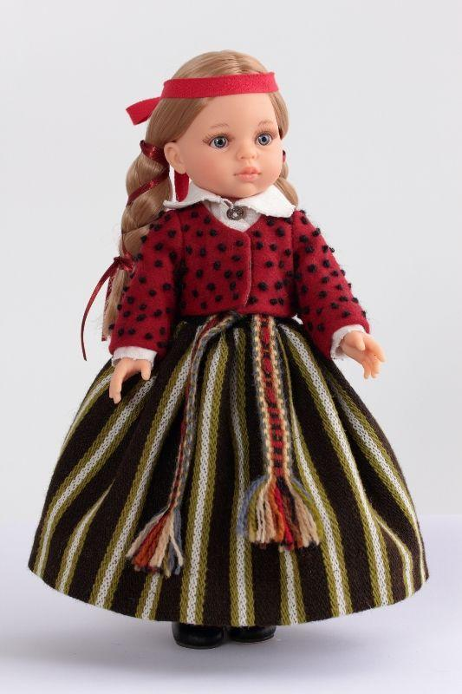
SOUVENIRE DOLLS IN LATVIAN NATIONAL FOLK COSTUMES. LATVIA HISTORICALLY IS DIVIDED IN FOUR REGIONS – ZEMGALE, KURZEME, VIDZEME, LATGALE. EACH REGION HAS MANY DIFFERENT FOLK COSTUMES.
Our roots
Kurzeme
Zemgale
Latgale
Vidzeme

Slide 13
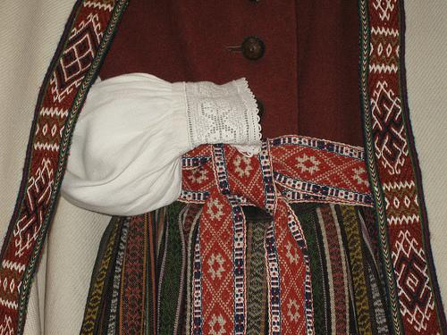
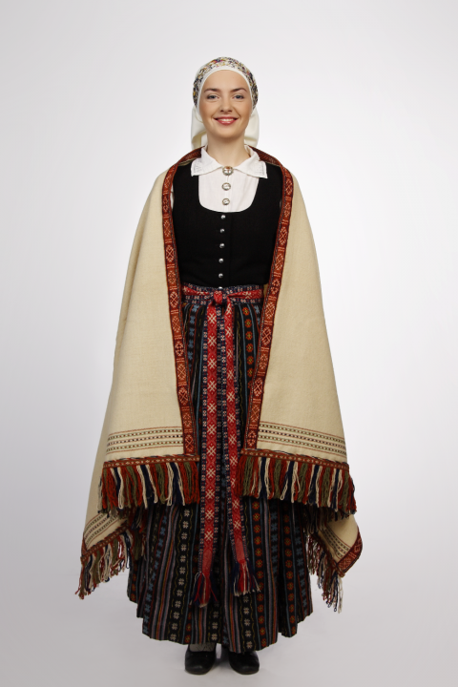
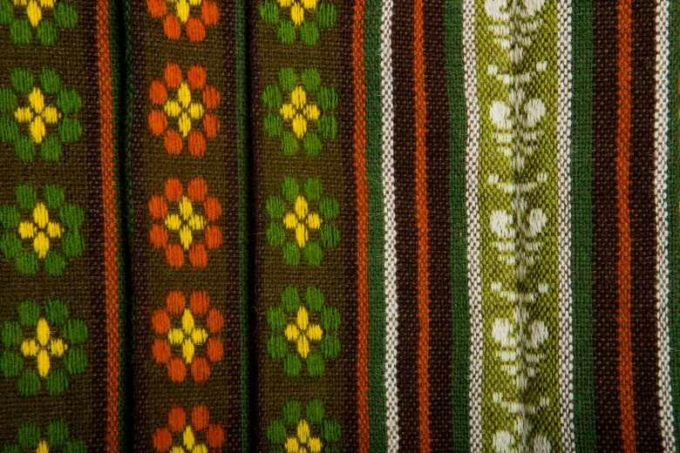
Jelgava is centre of historical Zemgale’s region. Folk costume.

Slide 14
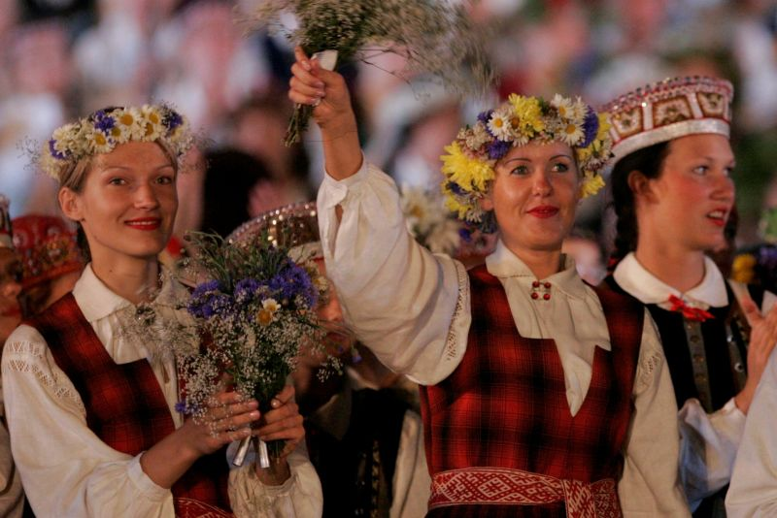
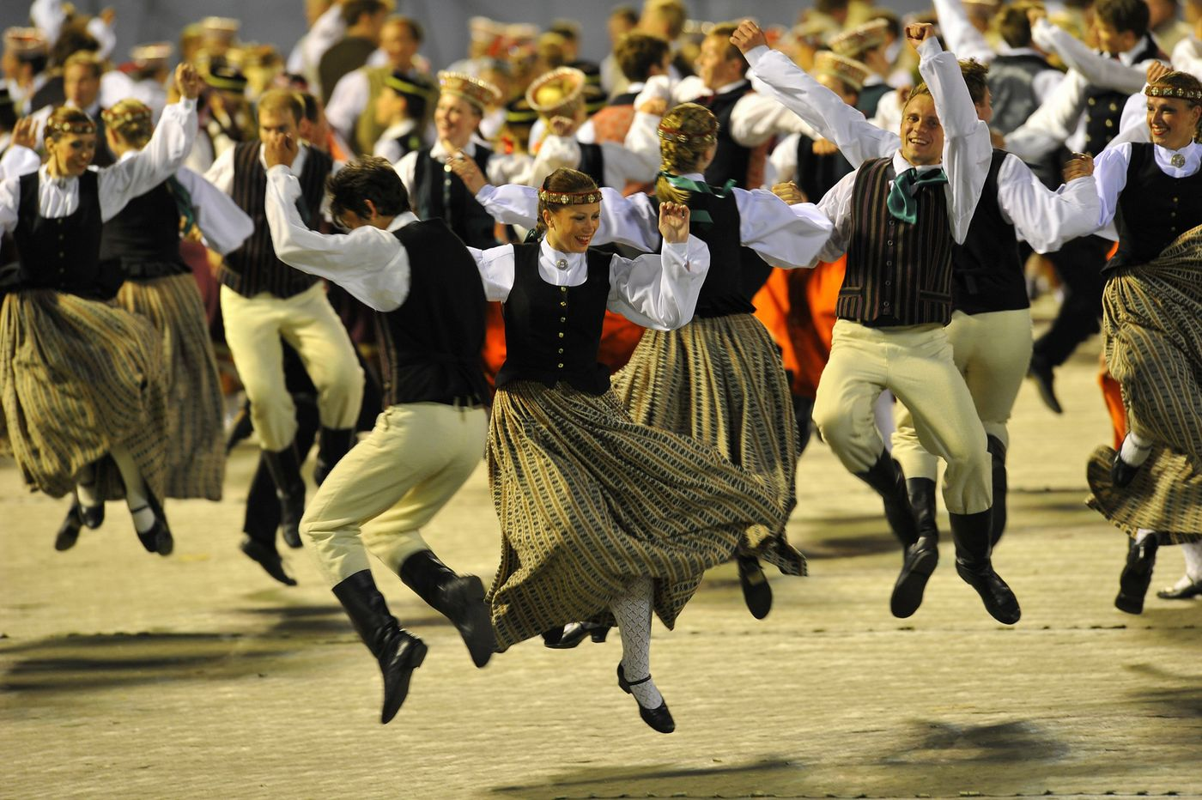
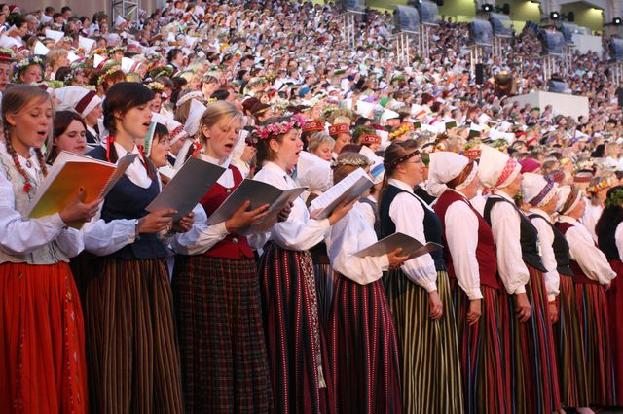
The participants of Song and Dance festival. It takes place in Riga once in four years.

Slide 15
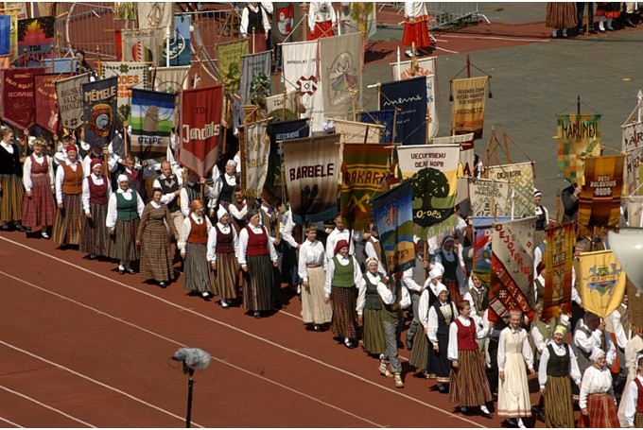
Song and Dance festival participant’s procession through the streets of Riga to the concert location - Wood park Stage (Mežaparka estrāde). In this march we can see all kinds of Latvian folk costumes.

Slide 16
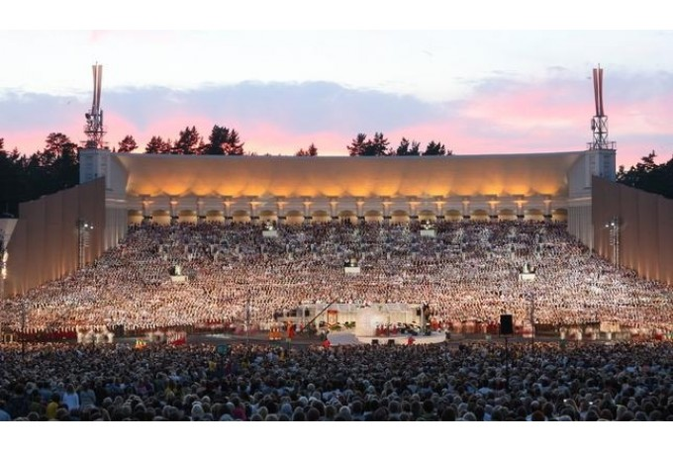
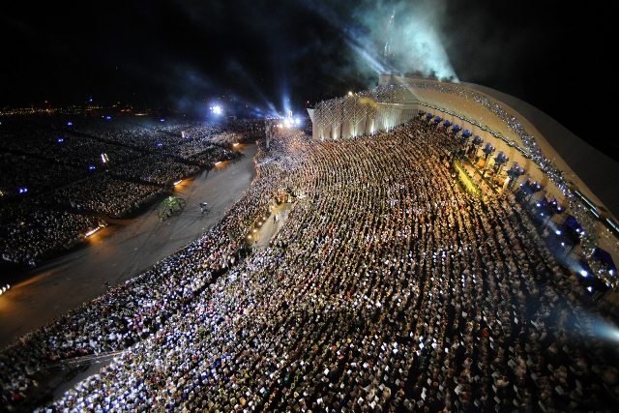
United choir consists of 20 000 singers. Song and Dance festival is big national celebration both for participants and spectators. Officially last concert ends at midnight, but after party, when singing each located in Mežaparks Stage, may end up at four in the morning.

Slide 17
Nature of Latvia
Latvia’s coasts are washed by Baltic Sea
The biggest river is Daugava, which begins in Russia. Its length is 1005 km, from which 300 km are in territory of Latvia where Daugava flows into Baltic Sea.

Slide 18
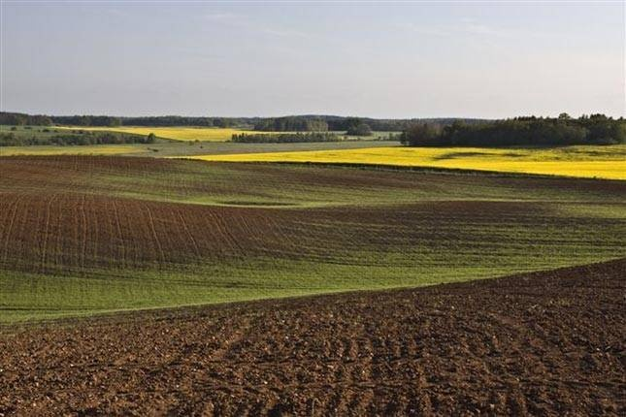
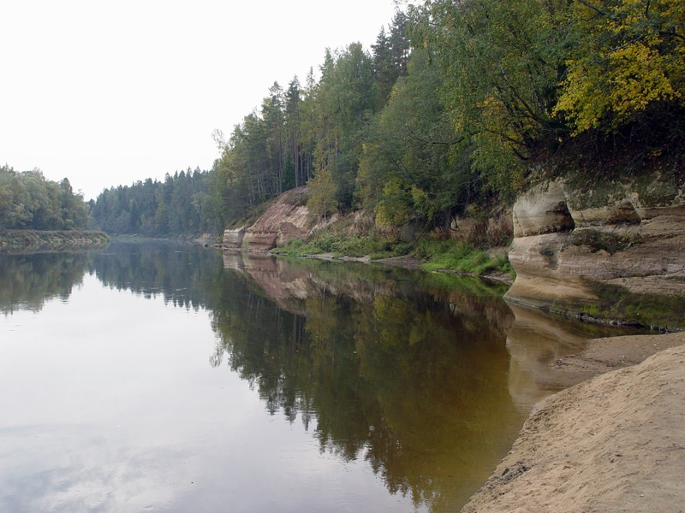
Typical plain landscape in Latvia.
There are 12 000 rivers and more than 2000 lakes in Latvia.

Slide 19
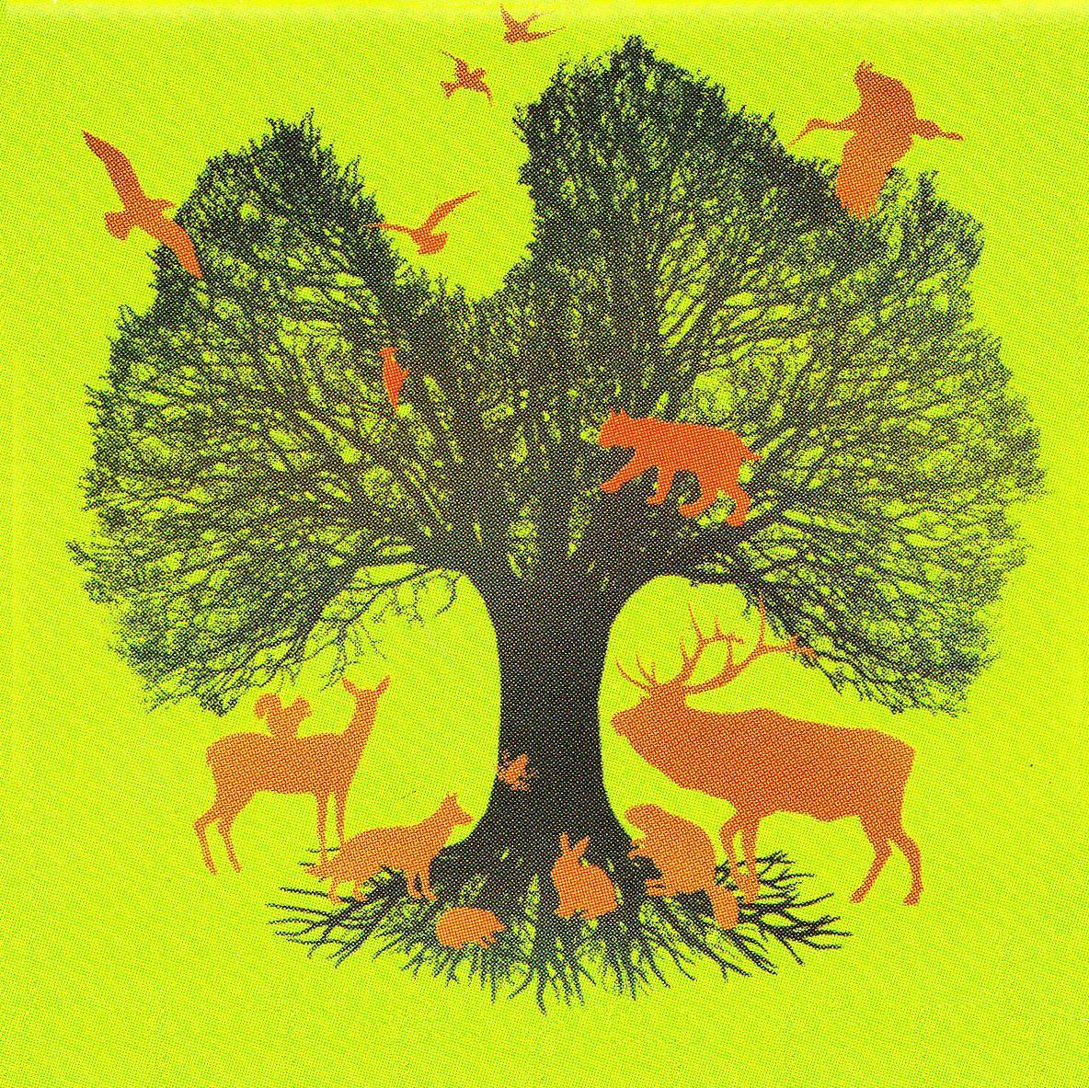
300 birth species are in Latvia. The biggest animal is elk. Foxes, wolves, red deers, roes, hares, squirrels, beavers and other animals live in our forests.

Slide 20
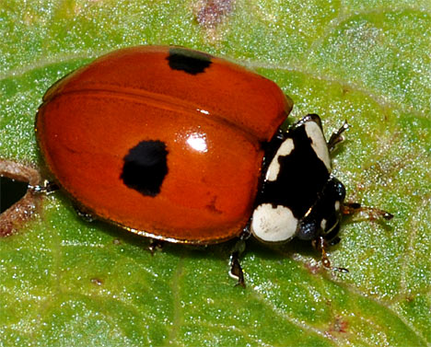
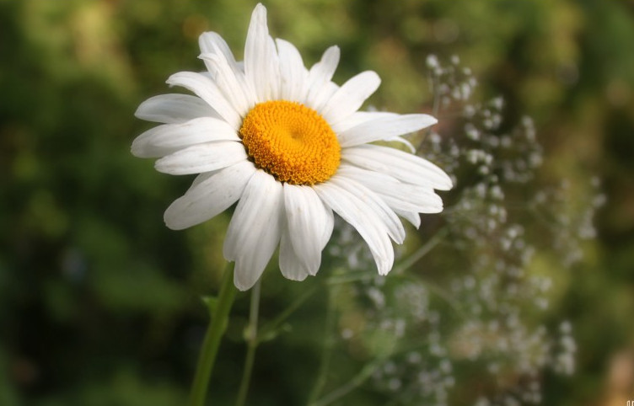
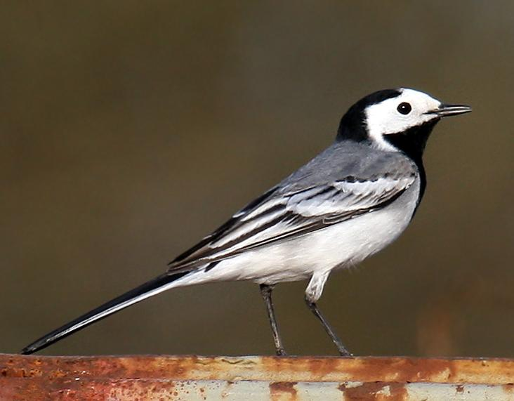
The national bug of Latvia is two-spot ladybird (Adalia bipunctata)
The national flower of Latvia is a daisy (Leucanthemum vulgare)
The national bird of Latvia is a white wagtail (Motacilla alba)

Slide 21
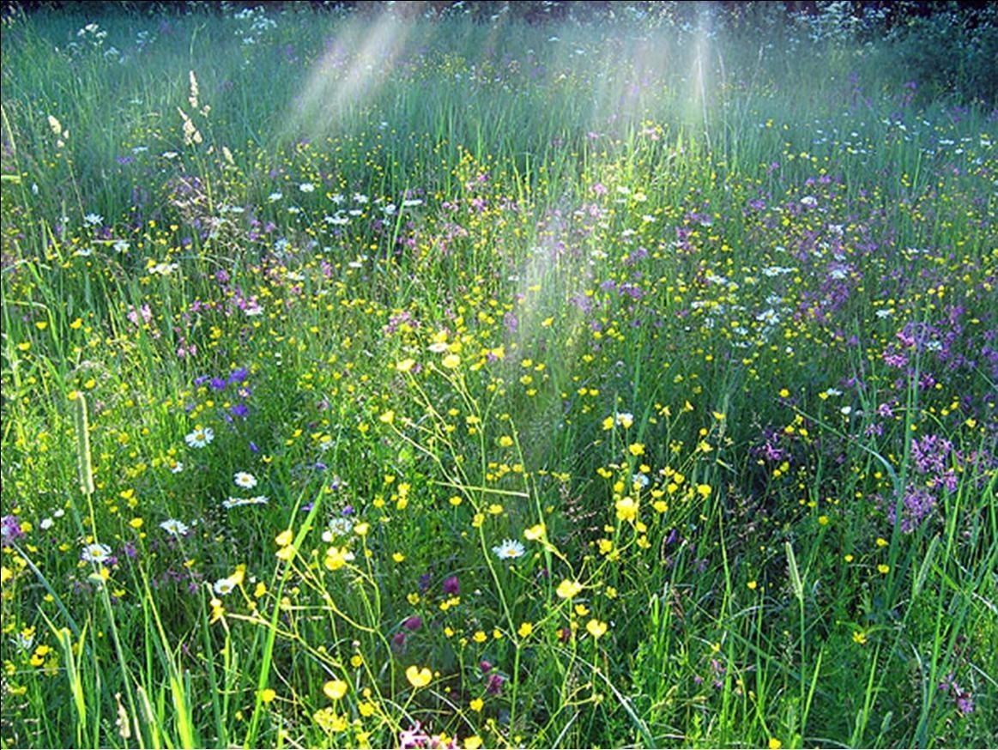
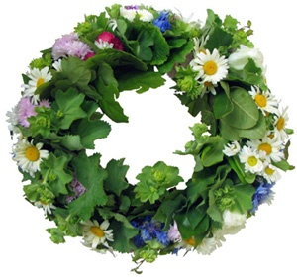
In summer whole Latvia celebrates Summer Solstice or John’s day. Līgo songs are sung and fires are made to wait the sunset.

Slide 22
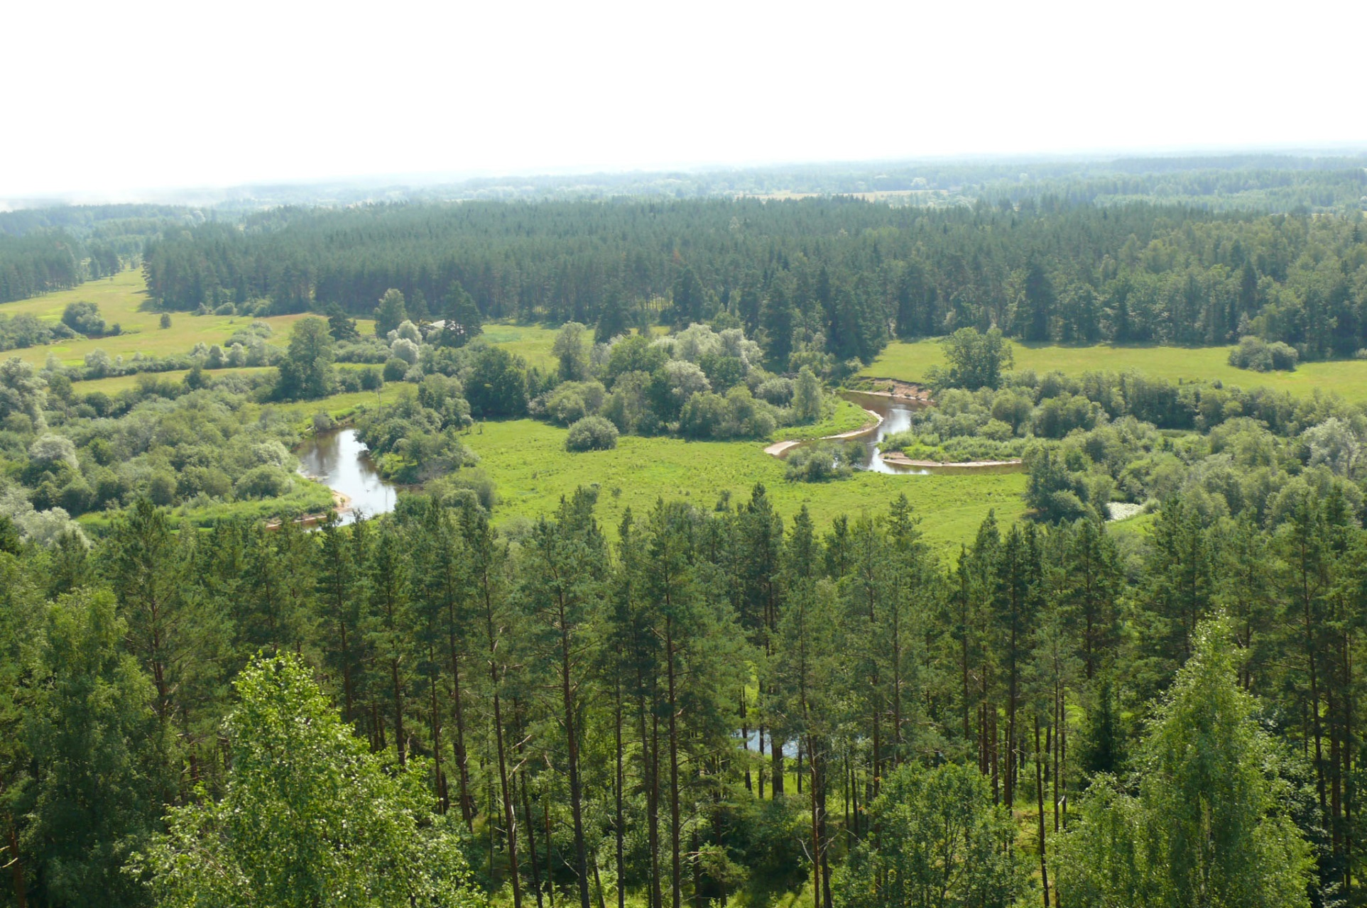
50% of Latvia’s territory is covered by forests. This is our «green gold».

Slide 23
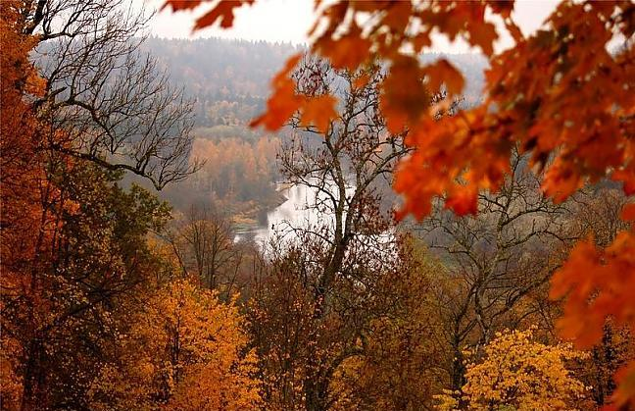
Autumn in Sigulda. The view to river Gauja – the longest river (460 km) in Latvia.

Slide 24
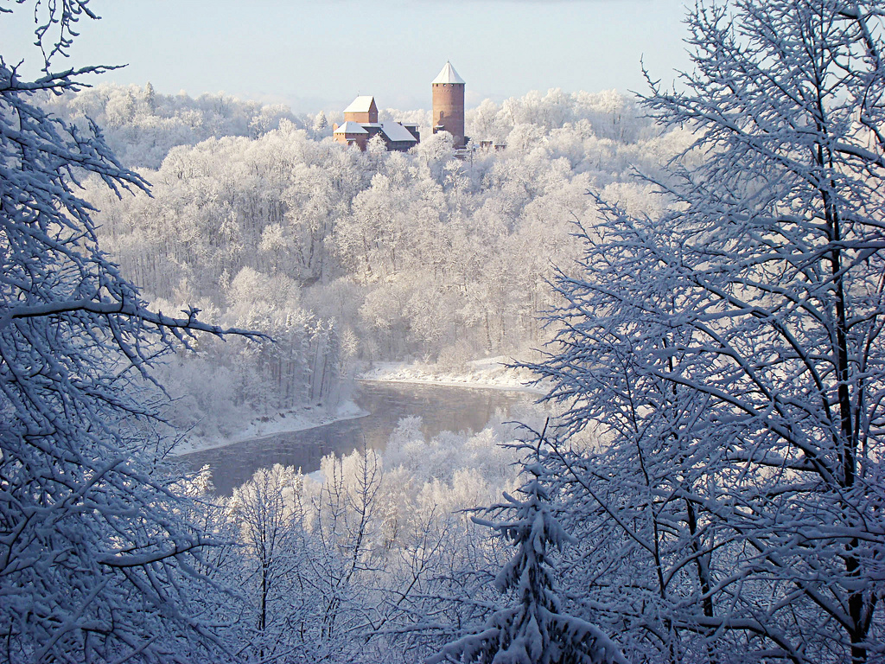
There is temperate climate in Latvia and 4 seasons. Average temperature in winter – 8 ⁰, summer + 20 ⁰.

Slide 25
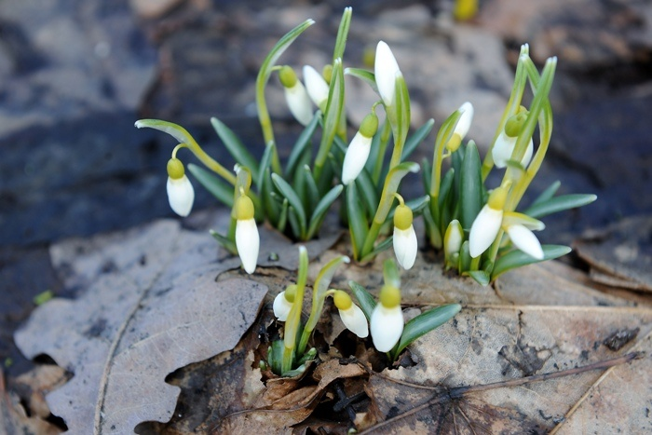
Eastern are celebrated in spring in Latvia. There are joined Christianity with ancient folk traditions. On that days people go to church and at the same time stained eggs and beat with eggs at home.

Slide 26
HISTORY OF LATVIA FUNNY KIND OF LATVIAN HISTORY BY "ANIMĀCIJAS BRIGĀDE". P.S. WE (ALL) THE PEOPLES OF LATVIA LOVE OUR LAND. WE DON`T MAKE THE DIFFERENCE BETWEEN RACES, NATIONALITIES. ONLY WHAT IS NEEDED- FREE CHOICE AND GOOD WILL.
https://youtu.be/EcKIeD3RxRQ

Slide 27
Thank you for attention!

