Slide 1
ES Mūžizglītības programmas
Comenius apakšprogrammas
Divpusējās partnerības projekts
„Studēt vai strādāt? Palikt vai aizbraukt?”
Līguma nr. 2012-1-LV1-COM07-03497 1

Slide 2
Jelgava secondary school No 4
96 respondents
Forms 10.-12.

Slide 3
Age

Slide 4
Gender

Slide 5
1.Do you want to study?

Slide 6
2. I want to study because…

Slide 7
3.I do not want to study because…

Slide 8
4. Do you want to study?

Slide 9
. 5. What motivates you to study abroud?

Slide 10
6. In what foreign country would you like to study?

Slide 11
6./7. What kind of experience with abroad do you have?

Slide 12
7./8. What do you think to study?

Slide 13
8. Do you want to emigrate?

Slide 14
9. I would like to emigrate because…

Slide 15
10. Why do you not want to emigrate?

Slide 16
11. What kind of job you think you will find in the country where you would like to emigrate?

Slide 17
12. If you emigrated, for what period of time would it be?

Slide 19
14. If you ansvered YES to the previous question, do you belive that the experiences these people had abroad influences your decision to emigrate?

Slide 20
9. Do you want to emigrate?

Slide 21
10. Why do you not want to emigrate?

Slide 23
12. If you answered YES to the previous question, do you belive that the experiences these people had abroad influences your decision NOT to emigrate?

Slide 24
15./13.What have to happen to make you to stay in your country ?

Slide 25
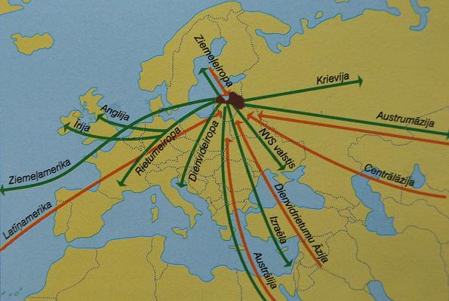
Portrait of the emigrant

Slide 26
Marial status

Slide 27
Children

Slide 28
Age

Slide 29
Level of education

Slide 30
Level of qualification

Slide 31
Opportunities for employment in Latvia

Slide 32
Problem with credits

Slide 33
Thank you for your attention!
19.04.2013.
Jelgava

